Slide 1


Syracuse University
Physics Department
Astronomy 101
Neutrinos and astronomy
Ohana Rodrigues

Slide 2
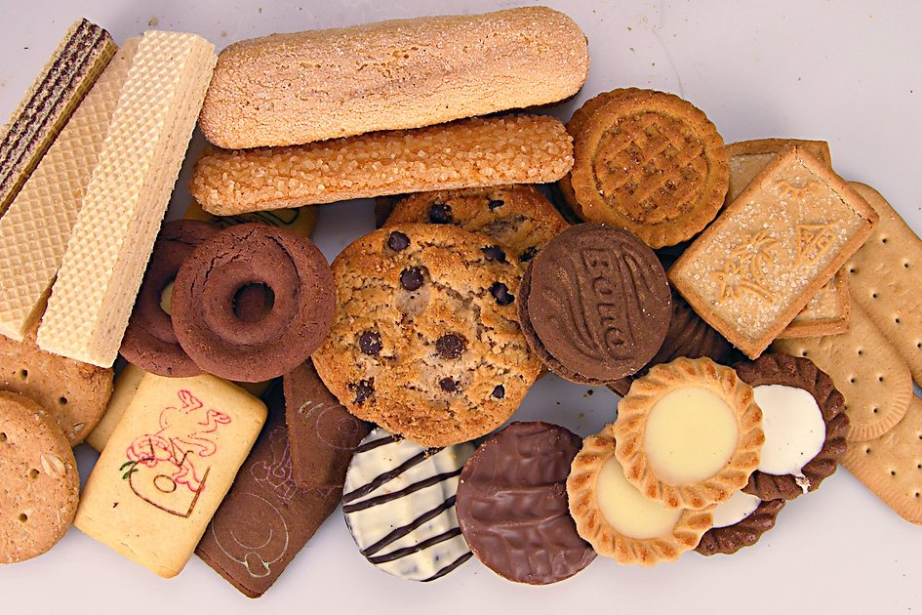
Portuguese word!!!
Biscoito

Slide 3



The Beta Decay
939,565 keV
938,272 keV
500 keV
$$939565-938272-500=$$
Kinetic Energy ?
793 keV

Slide 4
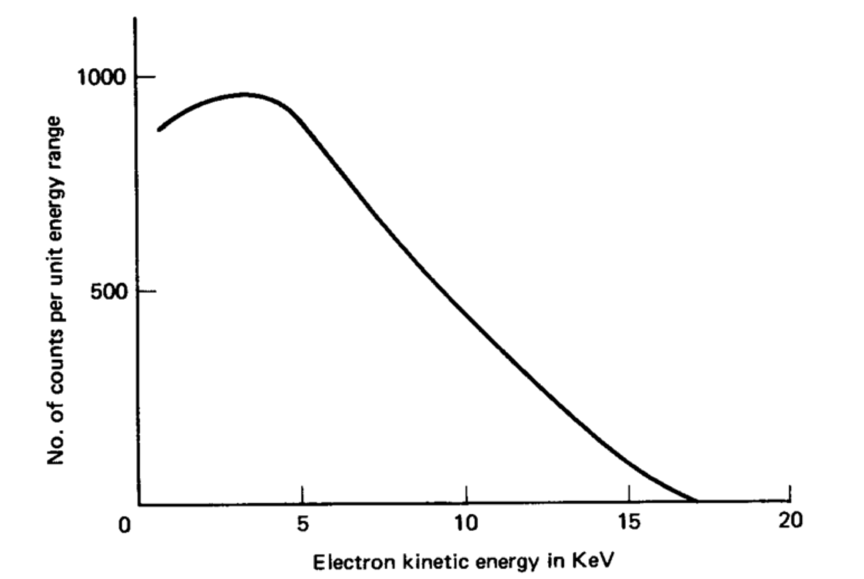
The Beta Decay - Expectation
796

Slide 5

The Beta Decay Problem - Reality
796

Slide 6
The Beta Decay Problem
796

Slide 7
The beta decay problem -
Two possible solutions
1. In this decay ENERGY IS NOT CONSERVED !!!
2. There is an invisible particle that carries the missing energy.

Slide 8

The Beta Decay Problem Solution

Slide 9
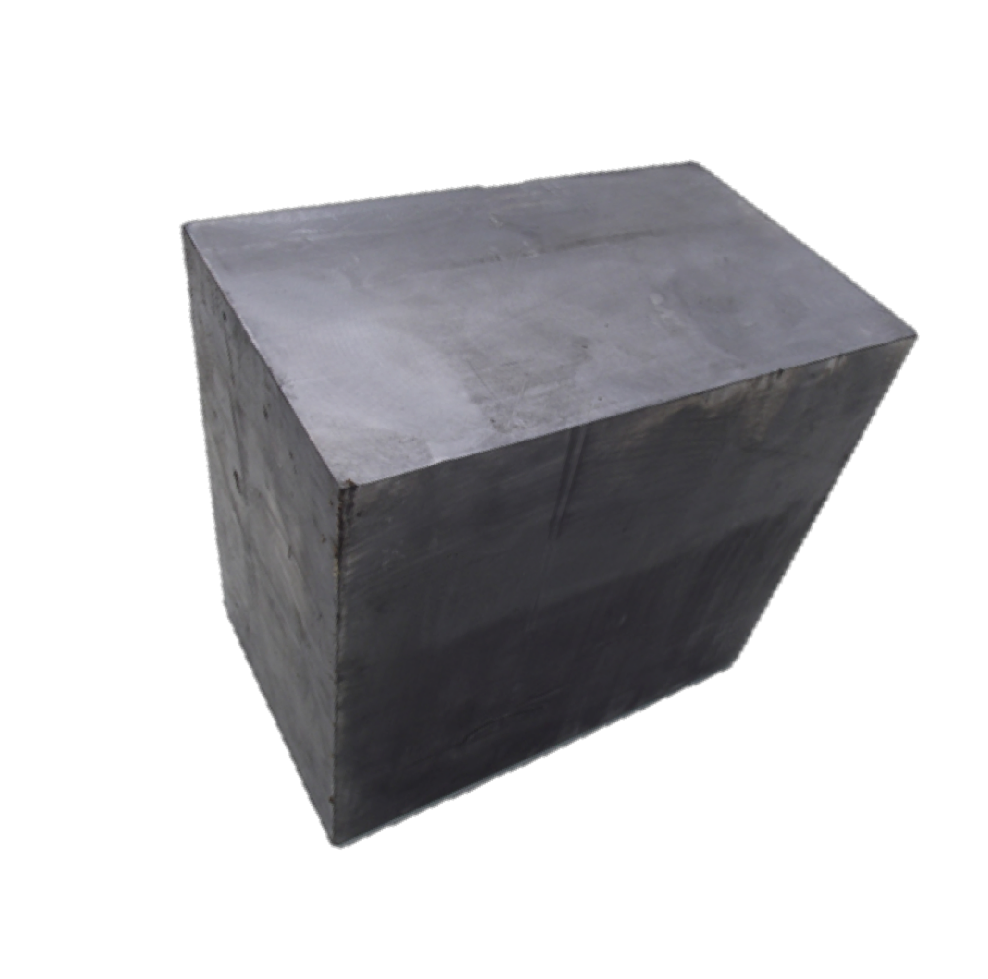
How Far Can a Neutrino Travel Through Lead ?
140 light-years !!!!

Slide 10

Neutrino's Personality List
They don’t like to interact (antisocial members of the particle’s family)

Slide 11




Neutrinos and Their Lepton Partners
They always show up accompanied by their favorite lepton
Electron
Electron-neutrino
Muon
Muon-neutrino
Tau
Tau-neutrino
We will name the neutrinos after their lepton partners and call this characteristic “flavor "

Slide 12
Neutrino's Personality List
They don’t like to interact (antisocial members of the particle’s family)
They come in three flavors:

Slide 13
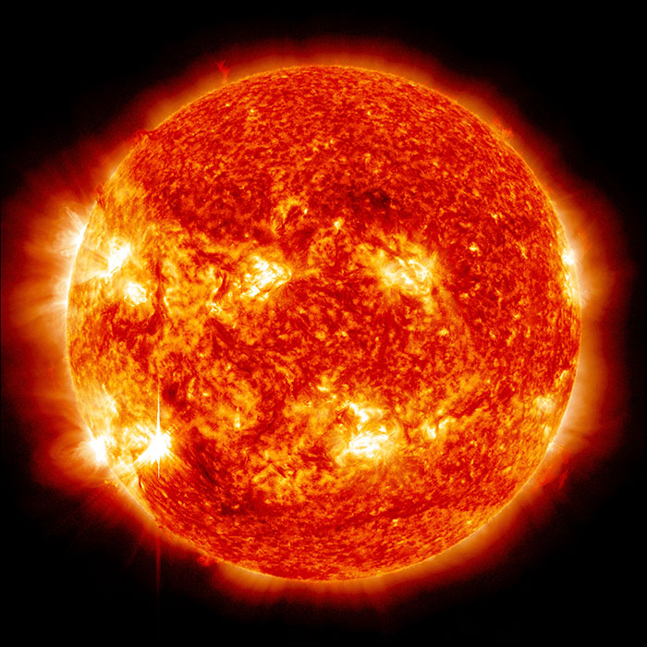
Solar Neutrinos
Nuclear Fusion
2 x
100 billion of neutrinos per $cm^{2}$ per second

Slide 14
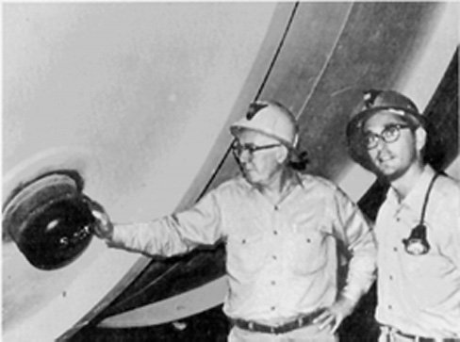
Solar Neutrinos Problem
John Bahcall
Raymond Davis
Only saw 1/3 of the expected neutrinos !!!!
Where were the other 2/3 ????
Chlorine
Argon

Slide 15
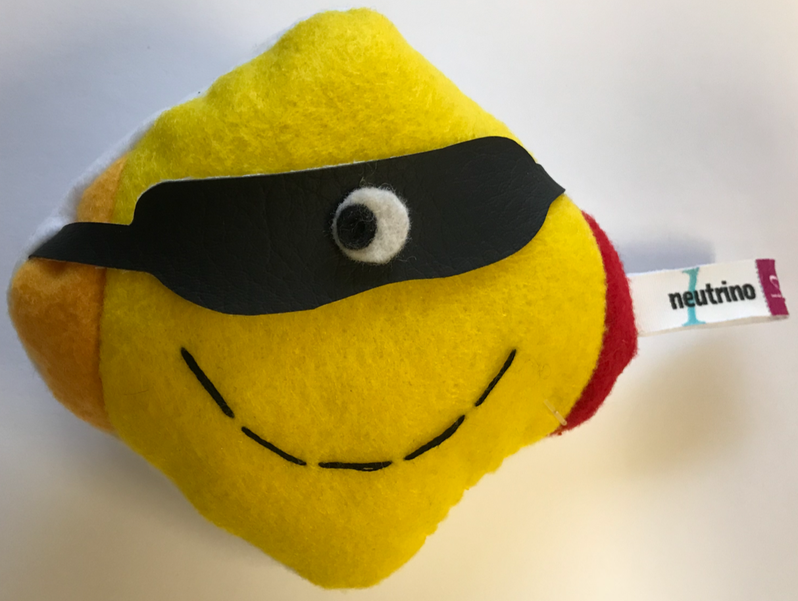
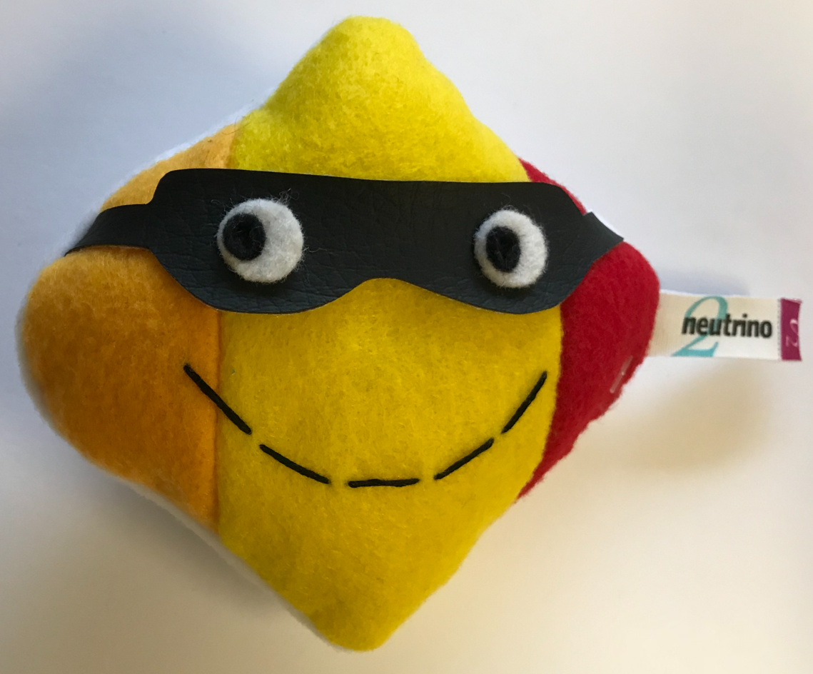
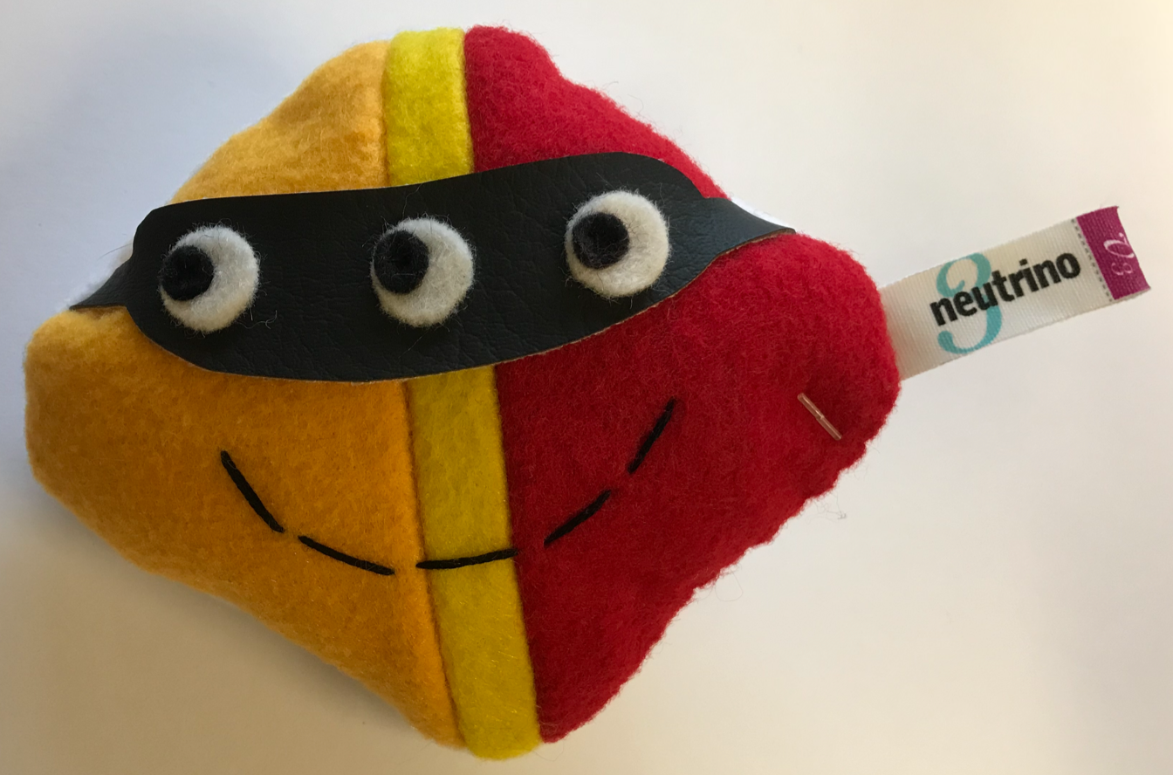






Solar Neutrinos Problem Solution: Neutrino Oscillation
a %
b %
c %
d %
e %
f %
g %
h %
i %
When they interact
As they travel

Slide 16
Solar Neutrinos Problem Solution: Neutrino Oscillation
Produced
Traveling
Interacting
In their way to Earth, the electron-neutrinos produced in the sun turned into the other flavor of neutrinos, and the detector was not sensitive to them!

Slide 17
Neutrino's Personality List
They don’t like to interact (antisocial members of the particle’s family)
They come in three flavors:
When they travel, they "oscillate" between those three flavors !

Slide 18

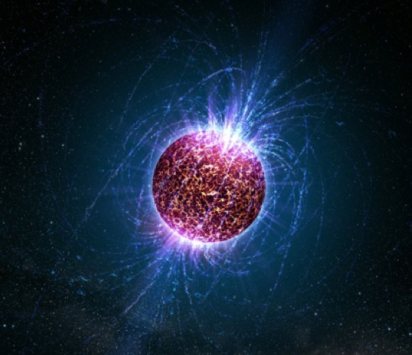

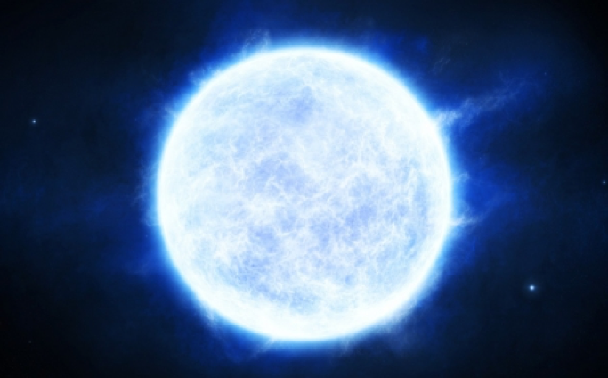
Supernova neutrinos
Light == Photons
Star explosion
Neutrinos

Slide 19


Supernova neutrinos
Why is that interesting ?
The photons carry all the interesting information about the Supernova.
Neutrinos are slower, but they leave the party earlier.
They get to Earth before the photons.
We can use the neutrino's signal as trigger !!!

Slide 20
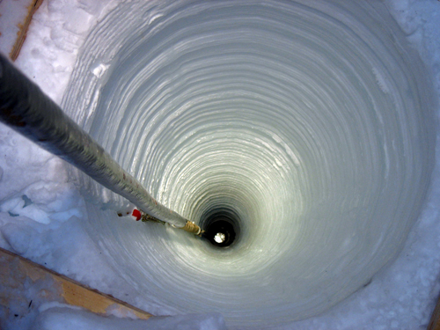
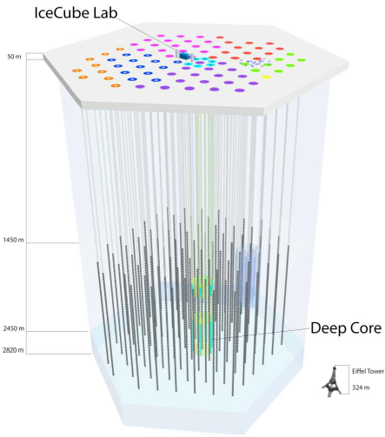
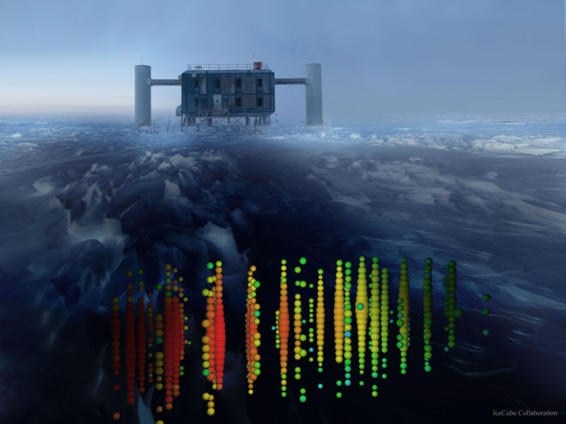
How Do We Measure Supernova Neutrinos?
We need a big, dense detector.
We can use the ice at Antarctica !!!
We dig huge holes in the ice
x 60

Slide 21
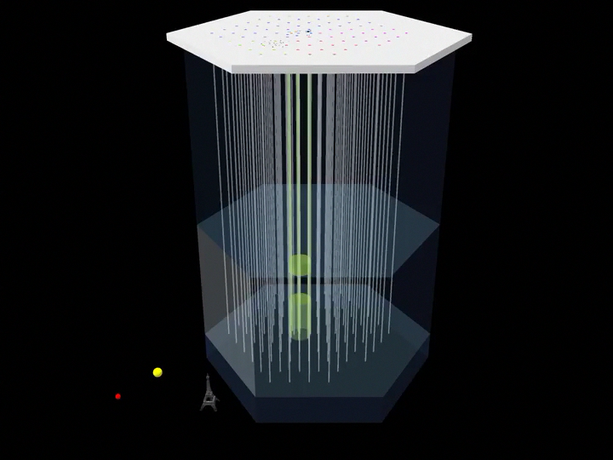
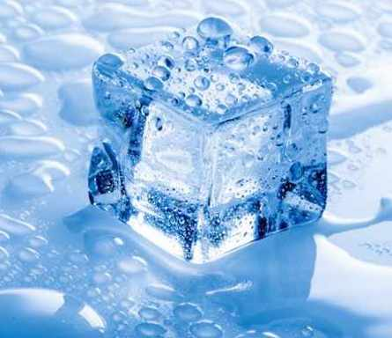

IceCube Neutrino Observatory
?
?
?

Slide 22
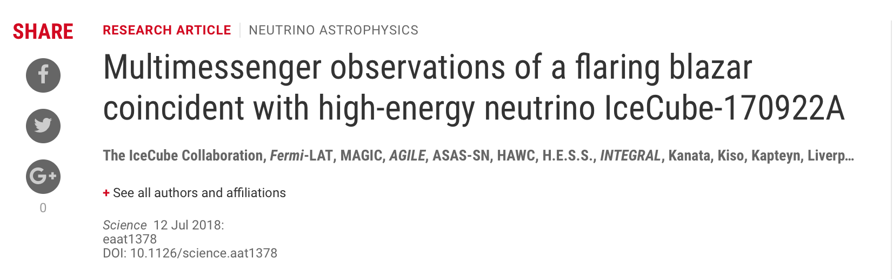
IceCube Neutrino Observatory

Slide 23

The Particle Zoo
https://www.particlezoo.net/

Slide 24

THANKS!!

Slide 25
References
• Cowan, Jr., C. L., Reines, F., Harrison, F. B., Kruse, H. W. and McGuire, A. D., Detection of the Free Neutrino: A Confirmation. Science. 1956.
• Griffiths,D.IntroductiontoElementaryParticlePhysics.Secondedition,Wiley-VCHVer- lag GmbH & Co. KGaA, Weinheim. ISBN 978-3-527-40601-2. 2008
• Bravo, S., No neutrino emission from a binary neutron star merger, available at http://icecube.wisc.edu/news/view/539
• Rajasekaran, G., THE STORY OF THE NEUTRINO, available at https://arxiv.org/pdf/1606.08715.pdf
• https://www.particlezoo.net
• Pavlović , Z., Neutrino beams and sources, available at http://npc.fnal.gov/wp-content/uploads/2017/06/2016-Zarko-Pavlovic-Sources.pdf
• Scholberg, K., Supernova Neutrino Detection , available at https://arxiv.org/pdf/1205.6003.pdf
• Hirata, K., et. al , Observation of a neutrino burst from the supernova SN1987A, available at https://journals.aps.org/prl/pdf/10.1103/PhysRevLett.58.1490
• Kouchner, A., High Energy Neutrino Astronomy and Neutrino Telescopes, available at
http://iopscience.iop.org/article/10.1088/1742-6596/593/1/012008/pdf

Slide 26
Backup

Slide 27
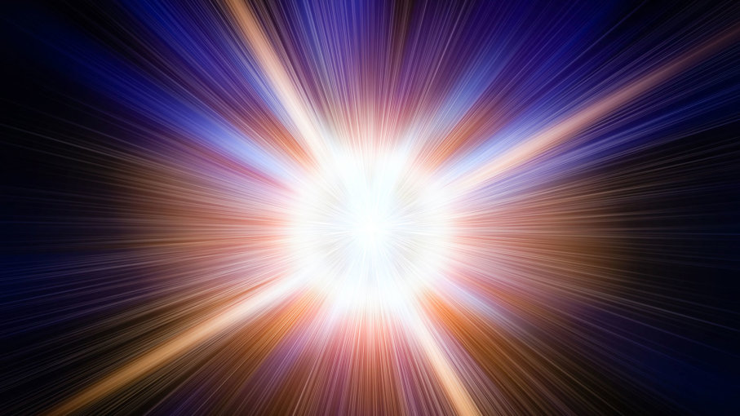

Matter- Antimatter Asymmetry
Particles
Antiparticles

Slide 28
Matter- Antimatter Asymmetry
There should be only photons left!!!

Slide 29


Matter- Antimatter Asymmetry

Slide 30
Matter- Antimatter Asymmetry
After some time

Slide 31
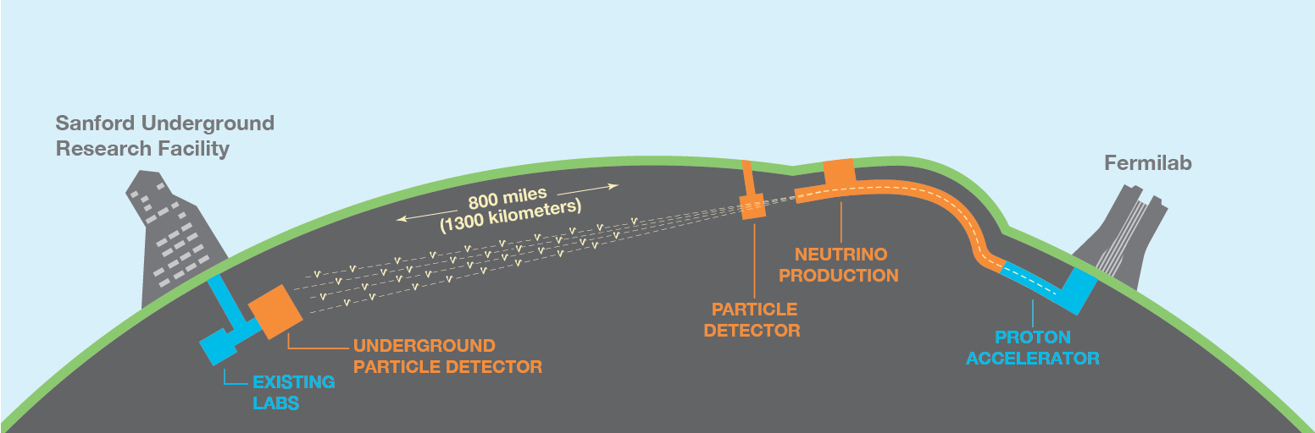
DUNE

Slide 32
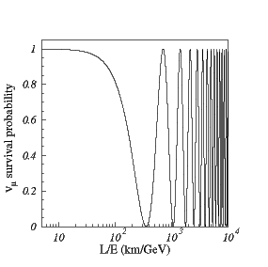
DUNE

